Slide 1
Teck Ghee Arc Outdoor

Slide 2
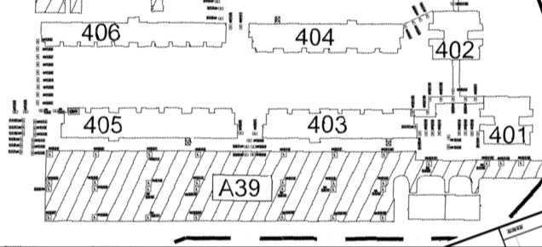
404
402
405
403
401
A39

Slide 3
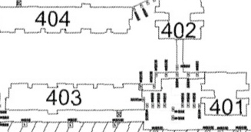
Outdoor 401,402,403 Linkway

Slide 4
402
403
401

